Slide 1
LOOPS

Slide 2
LOOPS IN R
repeat
for
while

Slide 3
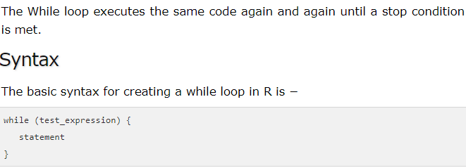

Slide 4
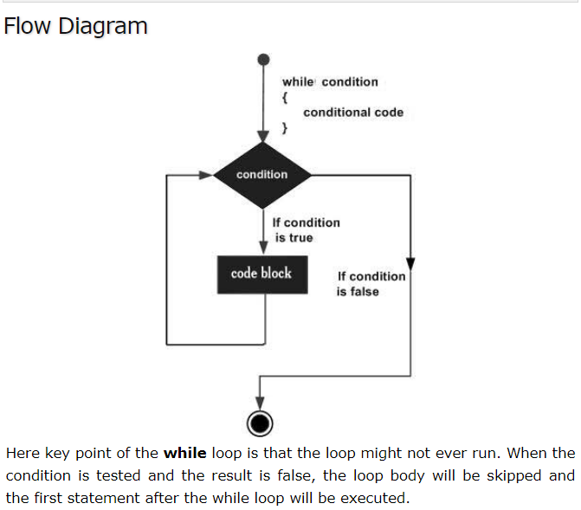

Slide 5
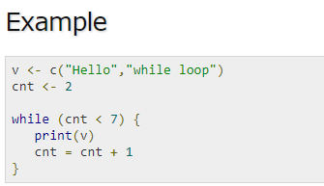

Slide 6
Write a program to print countdown from n to 0 using while loop

Slide 7
countdown = function(n)
{
print(n)
while(n!=0)
{
n = n - 1
print(n)
}
}
Countdown(5)

Slide 8
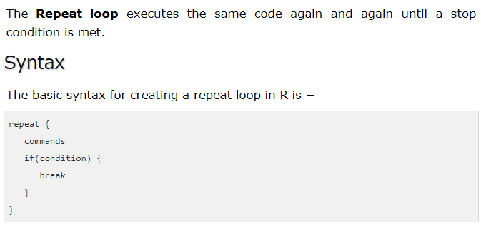

Slide 9
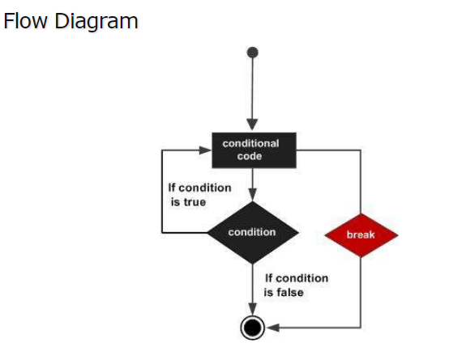

Slide 10
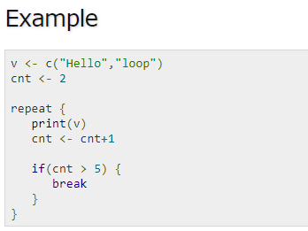

Slide 11
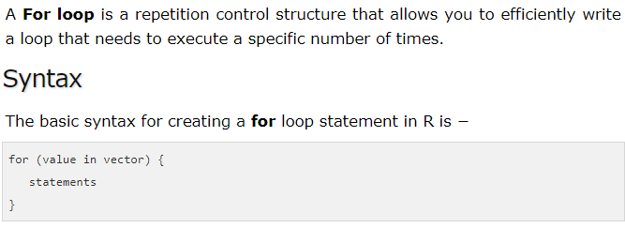

Slide 12
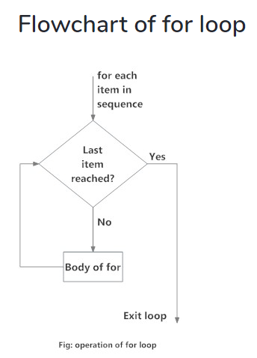

Slide 13
Find even numbers in the following list using for loop
2,5,3,9,8,11,6

Slide 14
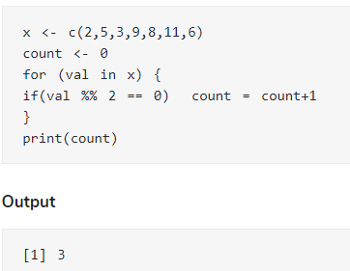

Slide 15
Find factorial of a number using for loop
Write a code for multiplication table
Write a code for prime number

